Slide 1
CPE 656
Software Engineering Studio I
Train Location Project
University of Alabama in Huntsville
November 16, 2015
Stephen Jalbert
Rashad Madyun
Corey Sanders

Slide 2
WORK PRODUCTS
Status
SDD: Added details for UI, Service, and Database
Geometry Collection: Collected Measurements with Fabric Tape Measure and verified Triangulation script
SDP & CMP: Renamed from “Team Operation Document”. Improved Formatting. Fixed Bad Picture Placement in Team Process Section

Slide 3
WORK PRODUCTS
Status (cd.)
SRS: Reformatted sections. Added Activity Diagrams for Use Cases. Eliminated unnecessary use cases.
Hardware: Worked on communication with RFID Reader. Soldered Headers onto IMU board so that it can connect to Arduino Mini

Slide 4
WORK PRODUCTS
Agenda (11/16 – 11/23)
SDP , CMP,
  Update Documents From Feedback
SRS
  Start incorporating feedback from last week.
SDD
  Add more details to GUI Design
  Add more details to Database Design
Geometry Collection
  Verify accuracy of laser range finder measurements from table mounts

Slide 5
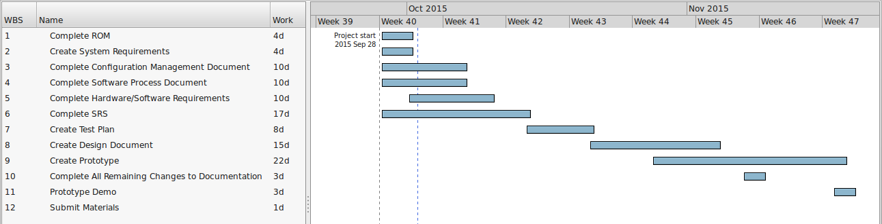
Schedule

Slide 6
Schedule (pt 2)
Work Product | Date Drafted Expected | Estimate Date for Completion
ROM | 10/1 | 10/1
SRS | 10/14 | 11/30 | Need to make less abstract
CM | 10/7 | 10/7
SDP | 10/7 | 10/7
STP | 10/21 | 11/30 | Need to clarify video testing
SDD | 11/4 | 11/30 | Need to add pseudo code for position estimation algorithm.
Prototype | 11/18 | 12/8 | Working on Hardware, Working on UI Mockup, Working on Geometry Points

